Slide 1



Noida Institute of Engineering and Technology, Greater Noida
Introduction
Unit: 1
Subject Name
Computer Organization and Architecture
Faculty Name: Dr. Vivek Kumar
Affiliation: Prof.
Department: IT
Course Details (B Tech 3rd Sem)

Slide 2
Content
Functional units of digital system and their interconnections
Bus and types of buses
Bus arbitration
Register bus and memory transfer
Processor organization
General register organization
Stack organization
Addressing modes
*CISC (Topic Beyond Syllabus)

Slide 3
Course Objective
1. Discuss the basic concepts and structure of computers
2. Understand concepts of register transfer logic and arithmetic operations
3. Explain different types of addressing modes and memory organization
4. Learn the different types of serial communication techniques
5. Summarize the Instruction execution stages

Slide 4
Course Outcome
S.NO | COURSE OUTCOME(CO) | CO –DESCRIPTION
1 | KCS 302.1 | Study of the basic structure and operation of a digital computer system.
2 | KCS 302.2 | Analysis of the design of arithmetic & logic unit and understanding of the fixed point and floating-point arithmetic operations.
3 | KCS 302.3 | Implementation of control unit techniques and the concept of Pipelining
4 | KCS 302.4 | Understanding the hierarchical memory system, cache memories and virtual memory
5 | KCS 302.5 | Understanding the different ways of communicating with I/O devices and standard I/O interfaces

Slide 5
CO-PO and PSO Mapping
 |  | COMPUTER ORGANIZATION AND ARCHITECTURE (KCS-302)
CO.K | PO1 | PO2 | PO3 | PO4 | PO5 | PO6 | PO7 | PO8 | PO9 | PO 10 | PO 11 | PO 12
KCS-302.1 | 3 | 2 | 1 | 1 | 1 | 1 | 1 | - | 1 | 1 | 1 | 2
KCS-302.2 | 2 | 2 | 2 | 2 | 1 | 1 | - | 1 | 1 | 1 | 1 | 2
KCS-302.3 | 3 | 2 | 2 | 1 | 2 | 2 | 1 | 1 | 2 | 2 | 1 | 2
KCS-302.4 | 3 | 2 | 2 | 2 | 2 | 1 | 1 | - | 1 | 1 | 1 | 2
KCS-302.5 | 2 | 2 | 2 | 1 | 2 | - | 1 | - | 1 | 2 | 2 | 2
Average | 2.6 | 2 | 1.8 | 1.4 | 1.6 | 1 | 0.8 | 0.4 | 1.2 | 1.4 | 1.2 | 2

Slide 6
Task 1: be ensure that are you added in CAO Class Group
Task 2: Recall last topic ( Computer System and Their Interconnections) & design it on your note book.
Task 3: Explain all Parts in details as I explained to you all.
Note: Attendance will be count only those students who will do given task.
***Be honest

Slide 7
CO-PO and PSO Mapping
 |  |  |  | COMPUTER ORGANIZATION AND ARCHITECTURE (KCS-302)
CO.K | PO1 | PO2 | PO3 | PO4 | PO5 | PO6 | PO7 | PO8 | PO9 | PO10 | PO11 | PO12
KCS-302.1 | 3 | 2 | 1 | 1 | 1 | 1 | 1 | - | 1 | 1 | 1 | 2
KCS-302.2 | 2 | 2 | 2 | 2 | 1 | 1 | - | 1 | 1 | 1 | 1 | 2
KCS-302.3 | 3 | 2 | 2 | 1 | 2 | 2 | 1 | 1 | 2 | 2 | 1 | 2
KCS-302.4 | 3 | 2 | 2 | 2 | 2 | 1 | 1 | - | 1 | 1 | 1 | 2
KCS-302.5 | 2 | 2 | 2 | 1 | 2 | - | 1 | - | 1 | 2 | 2 | 2
Average | 2.6 | 2 | 1.8 | 1.4 | 1.6 | 1 | 0.8 | 0.4 | 1.2 | 1.4 | 1.2 | 2
COMPUTER ORGANIZATION AND ARCHITECTURE (KCS-302)
CO.K | PSO1 | PSO2 | PSO3 | PSO4
KCS-302.1 | 3 | 3 | 3 | 2
KCS-302.2 | 2 | 2 | 2 | 1
KCS-302.3 | 3 | 3 | 3 | 2
KCS-302.4 | 2 | 3 | 3 | 2
KCS-302.5 | 2 | 3 | 3 | 1
Average | 2.4 | 2.8 | 2.8 | 1.6

Slide 8
Prerequisite and Recap
Basic knowledge of Computer Hardware
Basic knowledge of Digital Logic Design

Slide 9
Introduction
A computer can be defined as a fast electronic calculating machine that accepts data, process it and produces the resulting information
List of instruction are called programs and internal storage is called computer memory
Different types of computers are
Personal computers
Note book computers
Work stations
Enterprise systems
Super computers

Slide 10


Functional units and their interconnections
A computer consist of five main parts: Input, Memory, Arithmetic logic unit (ALU), Control unit and Output
Read ($\overline{R}$) : Active Low Signal (0)
Write (W) : Active High Signal (1)
IO(1)/ $\overline{M}$ (0)
Input
RAM
Instruction Details
2000 X3=X1+X2
3000 50
3001
3002 100
3003
3004 150
X3=X1+X2
X1, X2 and X3 are Memory Addresses
X1: 3000
X2: 3002
X3: 3004
Output
Processor
Control
Memory
$\overline{R}$/W
1001010010110000
Address
0010100101010001
ALU
1111011101100110
1001010010110000
1001010010110000
1001010010110000
Data Bus

Slide 11


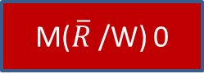
Input (0)
1/0
$\overline{I}$/O(1)
Output(1)
1/0
IO/ $\overline{M}$
Read(0)
1/0
M($\overline{R}$/W) 0
Write(1)

Slide 12
Functional units and their interconnections (Cont.)
Input unit
Data is transferred to a computer through input devices
Keyboard is a most common example of input device
Joysticks, trackballs, mouse, scanners etc are other input devices
Memory unit
Its function is to store programs and data
It is basically of two types: Primary and Secondary memory
RAM and ROM are the examples of primary memory
Magnetic disks & tapes, optical disks, floppies etc are examples of secondary memory

Slide 13
Functional units and their interconnections (Cont.)
Arithmetic logic and Shift Unit (ALU)
Most of the computer operators are executed in ALU of the processor like addition, subtraction, division, multiplication, etc
The operands are brought into the ALU from memory and stored in high speed storage elements called register
Timing and Control unit
It effectively is the nerve center that sends signals to other units and senses their states
The actual timing signals that govern the transfer of data between input unit, processor, memory and output unit are generated by the control unit

Slide 14
Functional units and their interconnections (Cont.)
Output unit
Its basic function is to send the processed results to the outside world
Printer, speakers, monitor etc are the examples of output devices

Slide 15
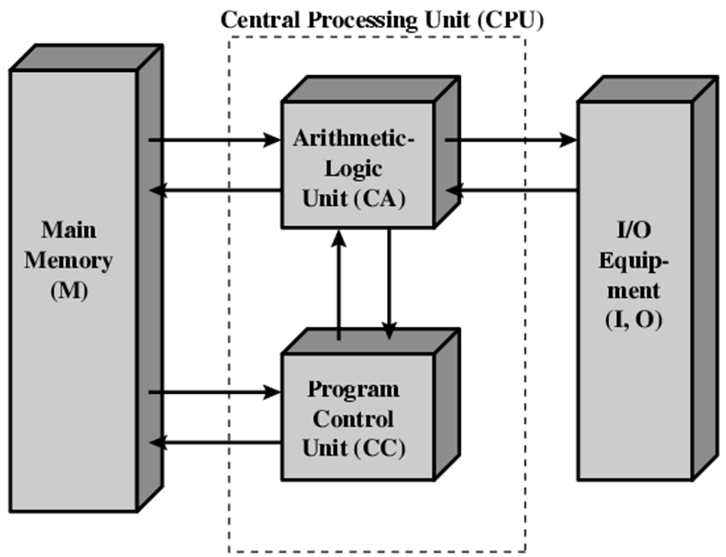
Functional units and their interconnections (Cont.)
Dr. Vivek Kumar COA KCS-302 Unit I

Slide 16
2. Bus and Types of Buses
Bus
Buses are the physical set of wires. The components of a computer systems are connected through these buses
A data connection between two or more devices connected to the computer
For example, a bus enables a computer processor to communicate with the memory or a video card to communicate with the memory.
A bus is capable of being a parallel or serial bus
There are three types of buses:
Address bus
Data bus
Control bus

Slide 17
Bus and Types of Buses (Cont.)
Address Bus
Used to specify the address of the memory location to access
CPU reads data or instructions from other locations by specifying the address of its location
Each I/O device has a unique address
CPU always outputs to the address bus and never reads from it
Data Bus
Actual data is transferred via the data bus
When the CPU sends an address to memory, the memory will send data via the data bus to the CPU

Slide 18
Bus and Types of Buses (Cont.)
Control Bus
Collection of Individual control signals
Whether the CPU will read or write data
CPU is accessing memory or an I/O device
Memory or I/O device is ready to transfer data
https://www.youtube.com/watch?v=xBYhHC8_A6o

Slide 19
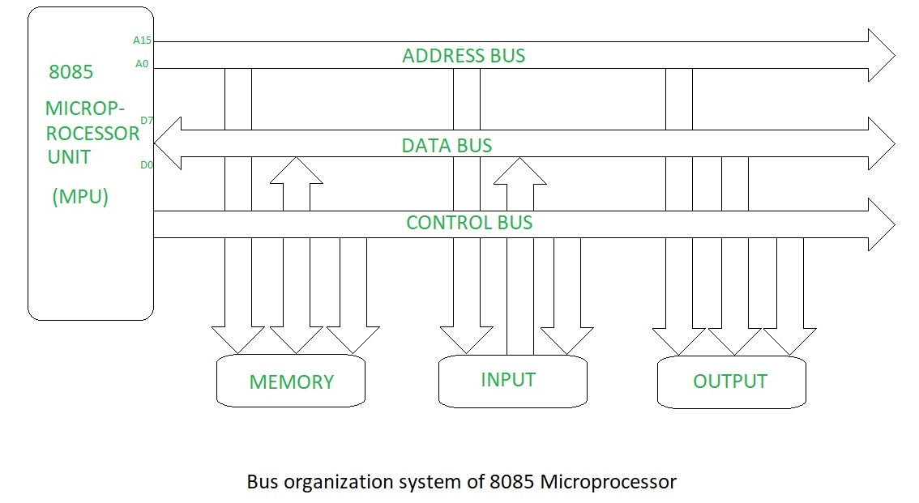
Bus and Types of Buses (Cont.)

Slide 20
Synchronous and Asynchronous Bus
Synchronous Bus:
Includes a clock in the control lines
A fixed protocol for communication that is relative to the clock
Advantage: involves very little logic and can run very fast
Disadvantages:
Every device on the bus must run at the same clock rate
To avoid clock skew, they cannot be long if they are fast
Asynchronous Bus:
It is not clocked
It can accommodate a wide range of devices
It can be lengthened without worrying about clock skew
It requires a handshaking protocol

Slide 21
3. Bus Arbitration
The arbitration procedure comes into picture whenever there are more than one processors requesting the services of bus
Because only one unit may at a time be able to transmit successfully over the bus, there is some selection mechanism is required to maintain such transfers. This mechanism is called as Bus Arbitration
Bus arbitration decides which component will use the bus among various competing requests
Various methods are available that can be roughly classified as either centralized or distributed.

Slide 22
Bus Arbitration (Cont.)
There are three arbitration schemes
Daisy chaining
Polling
Independent requesting
Daisy chaining method
It is a centralized bus arbitration method
I n this method, all requesting components are attached serially on to the bus
This method involves three control signals
BUS REQUEST
BUS GRANT
BUS BUSY

Slide 23
Bus Arbitration (Cont.)
All the bus units are connected to BUS REQUEST line
When activated, it indicates that one or more devices are requesting to use the bus
Bus Controller responds to a BUS REQUEST only if BUS BUSY is inactive. When bus control is given to requesting device, it enables its physical bus connection and activates BUS BUSY
W hen the first requesting device gets control of the bus and receives BUS GRANT, then it
blocks further propagation of signals, activates BUS BUSY and begins to use
When a non requesting device receives BUS GRANT signal, it forwards the signal to next device
Thus if two devices simultaneously request bus access, the device that is closer to the bus controller receives BUS GRANT and receives the bus control
The devices that are closed to the bus controller are of higher priority than those of the other devices

Slide 24
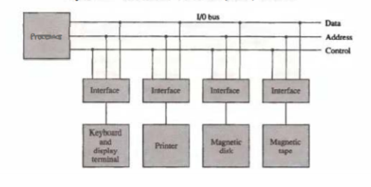

Slide 25
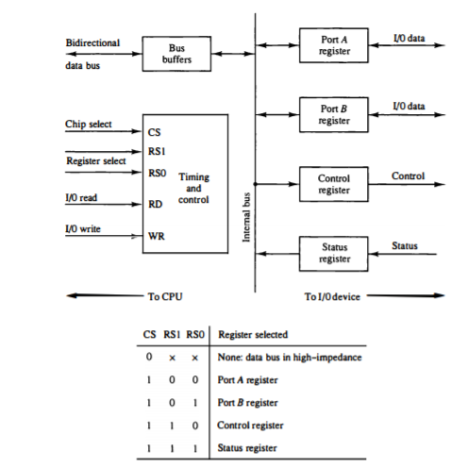

Slide 26
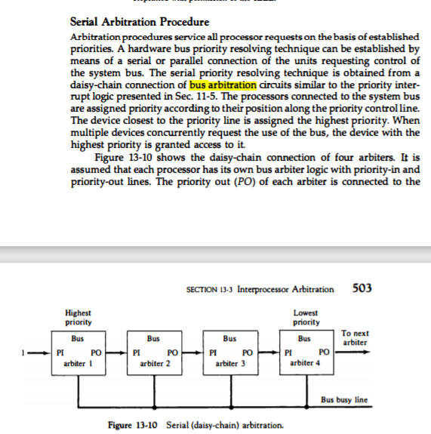
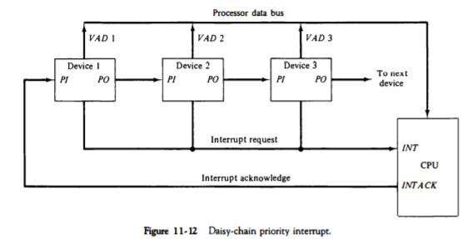

Slide 27
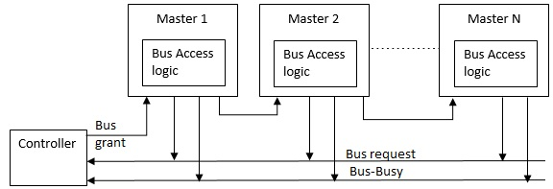
Bus Arbitration (Cont.)
Fig: Daisy chain method

Slide 28
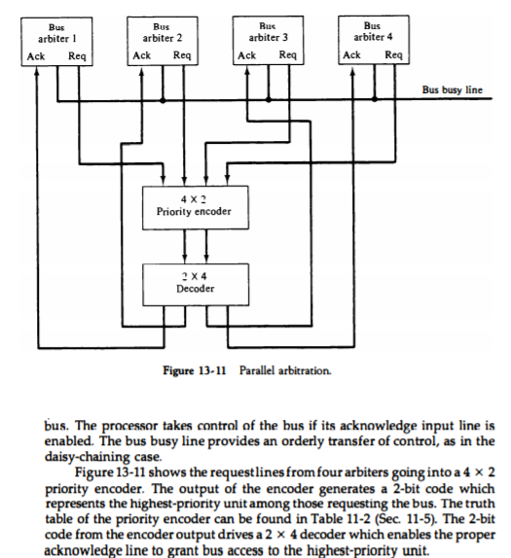

Slide 29
Bus Arbitration (Cont.)
Polling method
This method replaces the BUS GRANT line of daisy chain method with a set of poll count lines that are connected directly to all devices on the bus
Devices request access to the bus via a common BUS REQUEST line
Bus controller generates a sequence of numbers on the poll count lines
Each device compares these numbers as their device address already assigned to them
When a requesting device finds that its address matches the numbers on the poll-count lines, the device activates BUS BUSY
The bus controller responds by terminating the polling process and the device connects to the bus

Slide 30
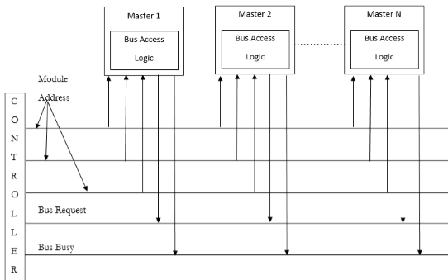
Bus Arbitration (Cont.)
Fig: Polling method

Slide 31
Bus Arbitration (Cont.)
Independent requesting method
There are separate BUS REQUEST and BUS GRANT lines for every device that are sharing bus.
In this, bus controller has the capability of immediate identifying all the requesting devices.
Bus controller responds rapidly to the request by determining the highest priority device that has sent the bus request.
This priority is programmable and is predetermined.
https://www.youtube.com/watch?v=B8_T0mMk0Ls

Slide 32
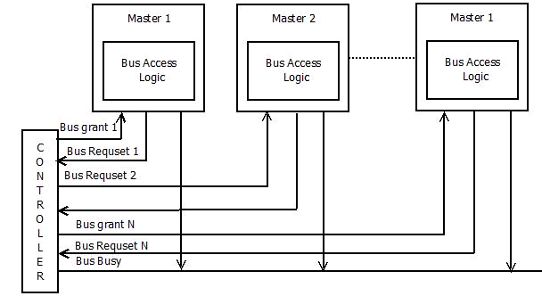
Bus Arbitration (Cont.)
Fig: Independent Requesting Method

Slide 33
4.Register bus and memory transfer
A typical digital computer has many registers, and paths must be provided to transfer information from one to another register for performing various operations in the computer system
The number of wires will be excessive if separate lines are used between each register to all other register
A more efficient and widely used method for transferring data between multiple register is common bus line system.

Slide 34
Register bus and memory transfer (Cont.)
Common Bus System
A bus structure consist a set of common lines each for each register, through which binary information can transfer one at time.
Control signal determine that which register is connected with a bus line at time to transfer the information.
There are two ways to construct a bus
By using multiplexers.
By three state buffer.

Slide 35
Register bus and memory transfer (Cont.)
Common bus system by using multiplexers
One way of constructing bus system is by using multiplexers. The multiplexer select the one register who’s information is transfer to another one destination register
In a bus system, multiplex K register of n bits each to produce an n lines common bus. The number of multiplexers needed to construct the bus is equal to n. Size of each mux is must be (k-1) multiplexer hence multiplexer have n data lines

Slide 36
Register bus and memory transfer (Cont.)
For example:
For common bus system using multiplexer for 16 register each of 32 bit data transformation
Solution: In this system we require 32(number of bits) multiplexer each having size of 16-1 multiplexer(number of register) and number of selection inputs are 4
Now we will briefly discuss an example of a bus system for 4 bit data transfer
The construction of bus system for four bit, four register is shown in next slide.

Slide 37
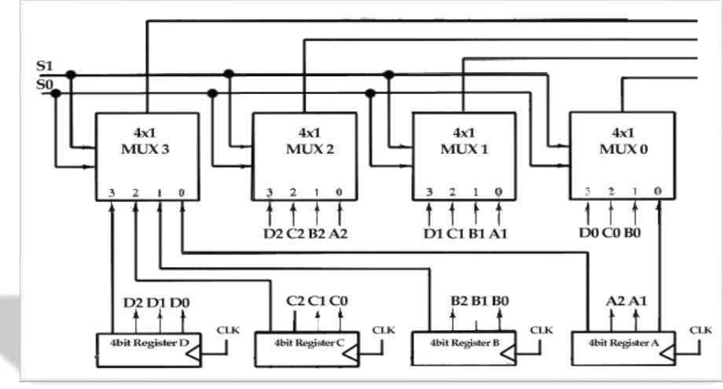
Register bus and memory transfer (Cont.)

Slide 38
Register bus and memory transfer (Cont.)
As we know that for n bit we require n multiplexer, for k register transfer we require k-1 size of multiplexer.
Here we have n=4 and k=4 hence here we use four multiplexer each having 4-1 size.
Here each register have 4 positive triggered flip- flop set. because each mux is 4-1 each multiplexer have 2 selection inputs in the bus.
we denote it by S0 and S1. This selection input select the one line output from 0 to 3 available in the each multiplexer, and applied to the output that form a bus system.
To avoid the complicated figure we just write output and input at the connection. For example output A1 of register A is connected with the input line 0 of mux(1) because that input is labeled as A1.

Slide 39
Register bus and memory transfer (Cont.)
In this section we will discuss how registers are selected by using two using two selection inputs
The two selection lines S and S are connected to the selection inputs of all four multiplexers.
The selection lines choose the four bits of one register and transfer them into the four-line common bus.
When S1S0 =00, the 0 data inputs of all four multiplexers are selected and applied to the outputs that form the bus.
This causes the bus lines to receive the content of register A since the outputs of this register are connected to the 0 data inputs of the multiplexers.
Similarly, register B is selected if S1S0= 0 1, and so on.

Slide 40
Register bus and memory transfer (Cont.)
Table shows the register that is selected by the bus for each of the four possible binary value of the selection lines.
S1 | S2 | Register Selected
0 | 0 | A
0 | 1 | B
1 | 0 | C
1 | 1 | D
Function Table for Bus

Slide 41
Register bus and memory transfer (Cont.)
General statement representation of transferring data between registers using bus system:
The transfer of information from a bus into one of many destination registers can be accomplished by connecting the bus lines to the inputs of all destination registers and activating the load control of the particular destination register selected.
The symbolic statement for a bus transfer may mention the bus or its presence may be implied in the statement.
When the bus is includes in the statement, the register transfer is symbolized as follows.
BUS C, R1 BUS

Slide 42
Register bus and memory transfer (Cont.)
The content of register C is placed on the bus, and the content of the bus is loaded into register R1 by activating its load control input.
If the bus is known to exist in the system, it may be convenient just to show the direct transfer.
R1 C
From this statement the designer knows which control signals must be activated to produce the transfer through the bus.

Slide 43
Register bus and memory transfer (Cont.)
Memory Transfer
Memory Transfer The transfer of information from a memory word to the outside environment is called a read operation.
The transfer of new information to be stored into the memory is called a write operation.
A memory word will be symbolized by the letter M. The particular memory word among the many available is selected by the memory address during the transfer.
It is necessary to specify the address of M when writing memory transfer operations.
This will be done by enclosing the address in square brackets following the letter M.

Slide 44
Register bus and memory transfer (Cont.)
Memory Read
The address register, symbolized by AR.
The data are transferred to another register, called the data register, symbolized by DR.
The read operation can be stated as follows:
Read: DR M[AR]

Slide 45
Register bus and memory transfer (Cont.)
Memory Write
Memory write this causes a transfer of information into DR from the memory word M selected by the address in AR.
The write operation transfers the content of a data register to a memory word M selected by the address.
Assume that the input data are in register R1 and the address is in AR.
The write operation can be stated symbolically as follows
Write: M[AR] R1

Slide 46
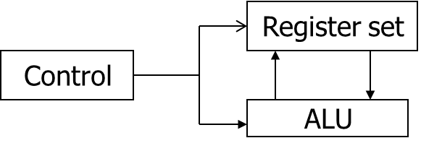
5. Processor Organization
Central Processing Unit
The CPU is made up of 3 major Components.
The CPU performs a variety of functions dictated by the type of instructions that are incorporated in the computer
In programming, memory locations are needed for storing pointers, counters, return addresses, temporary result , etc. Memory access is most time consuming operation in a computer.
It is then more convenient and more efficient to store these intermediate values in processor registers, which are connected through common bus system.

Slide 47
Processor Organization (Cont.)
Accumulator based CPU
Initially, computers had accumulator based CPUs.
It is a simple CPU in which the accumulator contains an operand for the Instruction.
The instruction leaves the result in the accumulator.
These CPUs have zero address & single address instruction. The Advantages : Short Instruction & less memory space. Instruction cycle takes less time because it saves time in Instruction fetching due to the absence of operand fetch. The Disadvantages : Program Size increases, memory size increases. Program execution time increases due to increase in program size.

Slide 48
Processor Organization (Cont.)
Register based CPU
Characteristics: Multiple registers are used. The use of registers result in short programs with limited instructions. The Advantages : Shorter Program size Increase in the number of registers, increases CPU efficiency. The Disadvantages : Additional memory accesses are needed. Compilers need to be more efficient in this aspect

Slide 49
Processor Organization (Cont.)
General Register Organization
Clock
R1
Input
R2
R3
R4
R5
R6
R7
Load
(7 lines)
SELA
MUX
MUX
SELB
3X8
decoder
A bus
B bus
Arithmetic logic unit
ALU
OPR
SELD
Control word
3 3 3 5
Output
SELA SELB SELD OPR

Slide 50
Processor Organization (Cont.)
Example of Microoperations:
R1 ←R2+R3
To Perform this operation, the control must provide binary selection variables to the following selector inputs:
1. MUX A selector (SELA): to place the content of R2 into bus A.
2. MUX B selector (SELB): to place the content of R3 into bus B.
3. ALU operation selector (OPR): to provide the arithmetic addition A+B.
Decoder destination selector (SELD): to transfer the content of the output bus into R1.
There are therefore 14 binary selection inputs , and their combination value specifies a control word.
A control Word (CW) is a word whose individual bits represent a various control signals.

Slide 51
Processor Organization (Cont.)
Stack Organization
The stack in digital computers is essentially a memory unit with an address register (Stack Pointer SP) that count only after an initial value is loaded into the stack.
SP value always point at the top item in the stack.
The two operations of stacks are the insertion (push), and deletion (pop) of items.
A stack can be organized as a collection of a finite number of memory words or registers.
In a 64-word stack, SP contains 6 bits because 2⁶ = 64.
The 1-bit register FULL is set to 1 when stack is full.
The 1-bit register EMTY is set to 1 when stack is empty.
DR is data register that holds the binary data to be written into or read out of the stack.

Slide 52
Processor Organization (Cont.)
Stack Organization
Mem. Unit
Address
Address
PC (Program Counter)
Program
(instructions)
1000
FULL
63
EMPTY
Data
(operands)
2000
AR (Address Data)
CPU
1504
4
Stack
3000
SP(Stack Pointer)
C
3
PC-1505
PC: PC+1
B
2
A
3997
Hold data to
be w/R i/o
of stack
1
SP
3998
0
3999
4000
DR
4001
DR (Data Register)
Block diagram of
a 64 word-register stack
6 bit SP
Computer memory with
program, data & stack segments

Slide 53
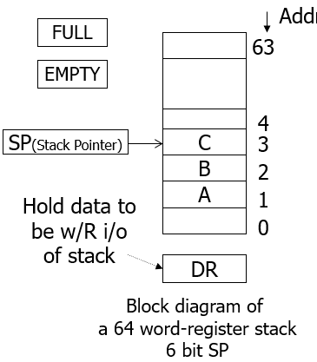
Processor Organization (Cont.)
In register stack
The push operation is implemented with the following sequence of microoperations:
SP SP+1 Increment stack pointer
M[SP] DR Write item on top of the stack
If (SP=0) then (FULL 1) Check if stack is full
(when 63 is incremented by 1, the result is 0.)
EMPTY 0 Mark the stack not empty
`

Slide 54
Processor Organization (Cont.)
In register stack
The push operation is implemented with the following sequence of microoperations:
SP SP+1 Increment stack pointer
M[SP] DR Write item on top of the stack
If (SP=0) then (FULL 1) Check if stack is full
(when 63 is incremented by 1, the result is 0.)
EMPTY 0 Mark the stack not empty

Slide 55
Processor Organization (Cont.)
In register stack
The pop operation consists the following sequence of microoperations:
DR M[SP] Read item from top of the stack
SP SP-1 Decrement stack pointer
If (SP=0) then (EMPTY 1 ) Check if stack is empty
FULL 0 Mark the stack not full
A stack can exist as a stand-alone unit or can be implemented in a RAM attached to a CPU.

Slide 56
Processor Organization (Cont.)
In memory stack
A stack can be implemented in a portion of a random –access memory attached to a CPU, and using a processor register as SP as shown the diagram above.
In the diagram shown Computer memory with program, data & stack segments:
PC (points at the address of the next instruction) is used during the fetch phase to read an instruction.
AR (points at an array of data) is used during the execution phase to read an operand.
SP is used push or pop items into or from the stack
The three registers are connected to a common address bus, & either one can provide an address for memory.
Push: insert (write) new item at the top of the stack
SP ← SP – 1, M[SP] ← DR
Pop: delete (read) the top item from the stack
DR ← M[SP], SP ← SP + 1

Slide 57
Processor Organization (Cont.)
In memory stack
The stack limits (overflow) can be checked by using 2 processor registers:
One to hold the upper limit (3000 in this example)
Another to hold the lower limit (4001 in this example )
SP is compared with the upper limit register after each push operation.
SP is compared with the lower limit register after each pop operation.
How many microoperations are needed then for the pop or push operations?
Two microoperations are needed for push or pop :
1. An access to memory through SP
2. Updating SP

Slide 58
Processor Organization (Cont.)
Reverse Polish Notation
A stack organization is very effective for evaluating arithmetic expressions.
The reverse Polish notation is in a form suitable for stack manipulation, where the infix expression A*B+C*D can be written in Reverse Polish Notation (RPN or postfix notation) as: AB*CD*+
Example: Stack operation to evaluate 3*4+5*6
=> 34*56*+ (in in reverse Polish notation )
6
4
5
5
30
3
3
12
12
12
12
42
3
4
*
5
6
*
+

Slide 59
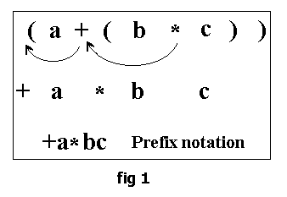
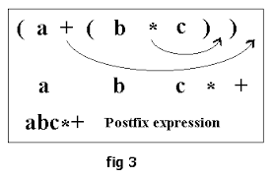

Slide 60
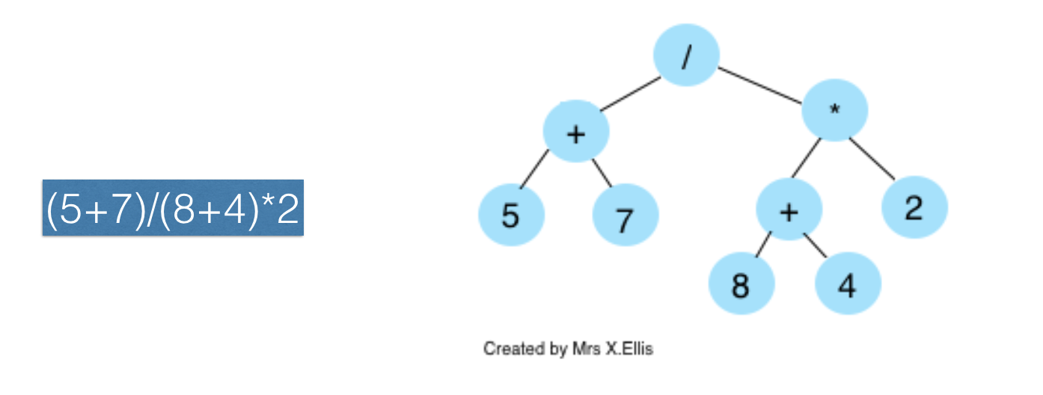

Slide 61
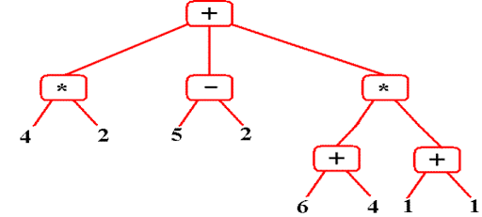
(4*2)+(5-2)+((6+4)*(1+1))

Slide 62
(i) (A*B)+(C*D)+(E*F)
Prefix (*AB)+(*CD)+(*EF)= (+*AB*CD)+(*EF)=++*AB*CD*EF
Postfix (AB*)+(CD*)+(EF*)=(AB*CD*+EF*+)
(ii) (A*B)+A*((B*D)+(C*E))
(*AB)+A*((*BD)+(*CE))
(*AB)+A*(+*BD*CE)
(*AB)+(*A+*BD*CE)
+*AB*A+*BD*CE
(iii) A*[B+(C*D)+E]/F*(G+H)
A*[B+(CD*)+E]/F*(GH+)
A*[(BCD*+)+E]/(FGH+*)
(ABCD*+E+*)/ (FGH+*)
ABCD*+E+*FGH+*/
A*B+(C*D)+E/F*(G+H)

Slide 63
Processor Organization (Cont.)
Instruction Formats
The bits of the instruction are divided into groups called fields.
The most common fields founded in the instruction formats are:
1. An operation code field
2. An address field
3. A mode field
Data executed by instructions (operands) are stored either in memory or in processor registers.
Operands residing in memory are specified by their memory address.
Operands residing in registers are specified with a register address.

Slide 64
Processor Organization (Cont.)
Instruction Formats
A register address is binary number of k bits that defines one of 2^k registers in the CPU.
Most computers fall into one of the 3 types of CPU organizations:
1. Single Accumulator (AC) Organization, i.e. ADD X
2. General register (Rs) Organization, ADD R1,R2,R3
3. Stack Organization, i.e. ADD (pop and add 2 operand then push the result into the stack)
Some computers combine features from more than one organization structure, Ex. Intel 8080 (GRs for register transfer, AC used in arithmetic operations)

Slide 65
Processor Organization (Cont.)
Addressing modes
The addressing mode specifies a rule for interpreting or modifying the address field of the instruction before the operand is actually executed.
Computers use addressing mode techniques for the purpose of accommodating one of the following provisions:
1. To give programming versatilities to the user to be more flexible.
2. To reduce the number of bits in the addressing field of the instruction.
In some some computers, the addressing mode of the instruction is specified with distinct binary code.
Instruction format with mode field
Opcode
Mode
Address

Slide 66
Processor Organization (Cont.)
Addressing modes
Other computers use a single binary for operation & Address mode.
The mode field is used to locate the operand.
Address field may designate a memory address or a processor register.
There are 2 modes that need no address field at all (Implied & immediate modes).
The most well known addressing mode are:
Implied mode.
Immediate mode
Register mode
Register Indirect mode
Auto-increment or Auto-decrement mode
Direct Mode
Indirect Mode
Relative Address Mode
Index Addressing Mode

Slide 67
Add C [AC]=[AC]+[C] AC(Accumulator)
LDA(Load Accumulator) 30
R1
Add B, D B=B+D
AND R4, R2, R3 R4=R2^R3
Add
Sub
80
7
3
34
50

Slide 68
SUB 45 [AC]=[AC]-45 ADD B, 3000 [B]=[B]+M[3000] ADD B, 3000, 3002 B=M[3000]+M[3002] ADD 3000, 3002 M[3000]=M[3000]+M[3002] ADD B,M
Hex Programming
Hexadecimal
0-9, A-F
Registers : B-C, D-E, H-L(8-8 Bits)
4-bits (address): 6754/ AB45
2-bits: (data) : 56/A9/8F
ADD B,45 B=B+45

Slide 69
B: 20 | C:30
D: | E:
H: 30 | L:00
1.Register Addressing
ADD B, C B=B+C
SUB D,H, L D=H-L
2. Direct Addressing At least one operand will be RAM address
ADD 2000, 3000
M[2000]= M[2000]+M[3000]
SUB 3000, B, 2000
M[3000]=[B]-M[2000]
ADD 3000 [AC]=[AC]+M[3000]
3. Indirect Addressing
ADD B,C, M effective address = 3000
[B]=[C]+M[[H-L]]
[B]=[B]+M[3000] [B]=20+70
4. Immediate Addressing | at least one operand will be data
ADI B, 30H | ADI C, 60
[B]=[B]+30
SUI 50 | [AC]=[AC]-50
ALU
RAM(Main Memory)
Address | Data
2000 | 50
2001
2002
…….
3000 | 70
3001
3002
…..
AC: 50

Slide 70
Relative Addressing Mode:
Effective address= [PC]+address part of instruction
Index Addressing Mode
Effective address= [index register]+address part of instruction
Base Addressing Mode
Effective Address = [Base Register]+address part of instruction
Implied Mode: without operands
work on content of AC only 10101=01010
Comp/ INC
Or on stack
ADD
/SUB
: it will work on Stack only
 | 70
 | 50
 | 60

Slide 73
Processor Organization (Cont.)
Numerical Example
PC=200
R1=400
Address
Memory
XR=100
AC
200
Load to AC Mode
201
Address=500
202
Next Instruction
Addressing mode eff. Add Content of AC
-----------------------------------------------------------
Direct Address 500 800
Immediate operand 201 500
Indirect Address 800 300
Relative Address 702 (PC=PC+2) 325
Indexes Address 600 (XR+500) 900
Register --- 400
Register Indirect 400 700
Auto-increment 400 700
Auto-decrement 399 450
399
450
400
700
500
800
600
900
702
325
800
300
Tabular list

Slide 74
Processor Organization (Cont.)
Different ways in which the address of an operand in specified in an instruction is referred to as addressing modes.
Register mode
Operand is the contents of a processor register.
Address of the register is given in the instruction.
E.g. Clear R1
Absolute mode
Operand is in a memory location.
Address of the memory location is given explicitly in the instruction.
E.g. Clear A
Also called as “Direct mode” in some assembly languages
Register and absolute modes can be used to represent variables

Slide 75
Processor Organization (Cont.)
Immediate mode
Operand is given explicitly in the instruction.
E.g. Move #200, R0
Can be used to represent constants.
Register, Absolute and Immediate modes contained either the address of the operand or the operand itself.
Some instructions provide information from which the memory address of the operand can be determined
That is, they provide the “Effective Address” of the operand.
They do not provide the operand or the address of the operand explicitly.
Different ways in which “Effective Address” of the operand can be generated.

Slide 76
Processor Organization (Cont.)
Indirect Mode
R1 and A are called “pointers”
Add (R1),R0
Add (A),R0
Main
memory
B
Operand
A
B
R1
B
Register
B
Operand
Register R1 contains Address B
Address A contains Address B
Address B has the operand
Address B has the operand
Effective Address of the operand is the contents of a register or a memory location whose address appears in the instruction

Slide 77
Processor Organization (Cont.)
Indexing Mode
Effective Address of the operand is generated by adding a constant value to the contents of the register
Add 20(R1),R0
Operand is at address 1020
Register R1 contains 1000
Offset 20 is added to the
contents of R1 to generate the
address 20
Contents of R1 do not change in the
process of generating the address
R1 is called as an “index register”
1000
offset = 20
1020
Operand
What address would be generated
by Add 1000(R1), R0 if R1 had 20?
R1
1000

Slide 78
Processor Organization (Cont.)
Relative mode
Effective Address of the operand is generated by adding a constant value to the contents of the Program Counter (PC).
Variation of the Indexing Mode, where the index register is the PC
instead of a general purpose register.
When the instruction is being executed, the PC holds the address of the next instruction in the program.
Useful for specifying target addresses in branch instructions.
Addressed location is “relative” to the PC, this is called “Relative Mode”

Slide 79
Processor Organization (Cont.)
Autoincrement mode
Effective address of the operand is the contents of a register specified in the instruction.
After accessing the operand, the contents of this register are automatically incremented to point to the next consecutive memory location.
(R1)+
Autodecrement mode
Effective address of the operand is the contents of a register specified in the instruction.
Before accessing the operand, the contents of this register are automatically decremented to point to the previous consecutive memory location.
-(R1)
Autoincrement and Autodecrement modes are useful for implementing “Last-In-First-Out” data structures

Slide 80
Video Links
Youtube videos links:
https://www.youtube.com/watch?v=xBYhHC8_A6o
https://www.youtube.com/watch?v=B8_T0mMk0Ls
https://www.youtube.com/watch?v=Za7ozdjE8VI
https://www.youtube.com/watch?v=u-sp4gBAJKI

Slide 81
Daily Quiz
1. RTL stands for:
a. Random transfer language
b. Register transfer language
c. Arithmetic transfer language
d. All of these
2. The register that includes the address of the memory unit is termed as the :
a. MAR
b. PC
c. IR
d. None of these
3. Which are the operation that a computer performs on data that put in register:
a. Register transfer
b. Arithmetic
c. Logical
d. All of these

Slide 82
Daily Quiz
4. Which operation puts memory address in memory address register and data in DR:
a. Memory read
b. Memory write
c. Both
d. None
5. A stack organized computer uses instruction of
a. Indirect addressing
b. Two addressing
c. Zero addressing
d. Index addressing
6. A flip flop is a binary cell capable of storing information of
a. One bit
b. One byte
c. Zero bit
d. Eight bits

Slide 83
Daily Quiz
7. To resolve the clash over the access of the system BUS we use ______ a. Multiple BUS b. BUS arbitrator c. Priority access d. None of the mentioned
8. The device which is allowed to initiate data transfers on the BUS at any time is called _____ a. BUS master b. Processor c. BUS arbitrator d. Controller

Slide 84
Weekly Assignments
1. Explain various methods of bus arbitration. [CO1]
2. Discuss various types of processor organization. [CO1]
3. Explain different addressing modes with the help of diagrams. [CO1]
4. Give the structure of a basic sequential ALU. [CO1]
5. Discuss the concept of register transfer. [CO1]
6. Explain different types of addressing modes. [CO1]
7. Differentiate between Computer Organization and Computer Architecture. [CO1]
8. Explain the concept of General Register Organization in detail. [CO1]

Slide 85
MCQ
1. To resolve the clash over the access of the system BUS we use ______ a) Multiple BUS b) BUS arbitrator c) Priority access d) None of the mentioned
Answer: b
2. The device which is allowed to initiate data transfers on the BUS at any time is called _____ a) BUS master b) Processor c) BUS arbitrator d) Controller Answer: a
3. ______ BUS arbitration approach uses the involvement of the processor. a) Centralized arbitration b) Distributed arbitration c) Random arbitration d) All of the mentioned Answer: a

Slide 86
MCQ
4. The circuit used for the request line is a _________ a) Open-collector b) EX-OR circuit c) Open-drain d) Nand circuit Answer: c
5. The Centralized BUS arbitration is similar to ______ interrupt circuit. a) Priority b) Parallel c) Single d) Daisy chain Answer: d
6. When the processor receives the request from a device, it responds by sending _____ a) Acknowledge signal b) BUS grant signal c) Response signal d) None of the mentioned Answer: b

Slide 87
MCQ
7. In Centralized Arbitration ______ is/are is the BUS master. a) Processor b) DMA controller c) Device d) Both Processor and DMA controller Answer: d
8. Once the BUS is granted to a device ___________ a) It activates the BUS busy line b) Performs the required operation c) Raises an interrupt d) All of the mentioned Answer: a
9. The BUS busy line is made of ________ a) Open-drain circuit b) Open-collector circuit c) EX-Or circuit d) Nor circuit Answer: b

Slide 88
MCQ
10. After the device completes its operation _____ assumes the control of the BUS. a) Another device b) Processor c) Controller d) None of the mentioned Answer: b
11. The BUS busy line is used __________ a) To indicate the processor is busy b) To indicate that the BUS master is busy c) To indicate the BUS is already allocated d) None of the mentioned Answer: c
12. Distributed arbitration makes use of ______ a) BUS master b) Processor c) Arbitrator d) 4-bit ID Answer: d

Slide 89
MCQ
13. In Distributed arbitration, the device requesting the BUS ______ a) Asserts the Start arbitration signal b) Sends an interrupt signal c) Sends an acknowledge signal d) None of the mentioned Answer: a
14. How is a device selected in Distributed arbitration? a) By NANDing the signals passed on all the 4 lines b) By ANDing the signals passed on all the 4 lines c) By ORing the signals passed on all the 4 lines d) None of the mentioned Answer: c
15. If two devices A and B contesting for the BUS have ID’s 5 and 6 respectively, which device gets the BUS based on the Distributed arbitration. a) Device A b) Device B c) Insufficient information d) None of the mentioned Answer: b

Slide 90
MCQ
16. The decoded instruction is stored in ______ a) IR b) PC c) Registers d) MDR Answer: a
17. The instruction -> Add LOCA, R0 does _______ a) Adds the value of LOCA to R0 and stores in the temp register b) Adds the value of R0 to the address of LOCA c) Adds the values of both LOCA and R0 and stores it in R0 d) Adds the value of LOCA with a value in accumulator and stores it in R0 Answer: c
18. Which registers can interact with the secondary storage? a) MAR b) PC c) IR d) R0 Answer: a

Slide 91
MCQ
19. During the execution of a program which gets initialized first? a) MDR b) IR c) PC d) MAR Answer: c
20. Which of the register/s of the processor is/are connected to Memory Bus? a) PC b) MAR c) IR d) Both PC and MAR Answer: b
21. ISP stands for _________ a) Instruction Set Processor b) Information Standard Processing c) Interchange Standard Protocol d) Interrupt Service Procedure Answer: a

Slide 92
MCQ
22. The internal components of the processor are connected by _______ a) Processor intra-connectivity circuitry b) Processor bus c) Memory bus d) Rambus Answer: b
23. ______ is used to choose between incrementing the PC or performing ALU operations. a) Conditional codes b) Multiplexer c) Control unit d) None of the mentioned Answer: b
24.The registers, ALU and the interconnection between them are collectively called as _____ a) process route b) information trail c) information path d) data path Answer: d

Slide 93
MCQ
25. In the case of, Zero-address instruction method the operands are stored in _____ a) Registers b) Accumulators c) Push down stack d) Cache Answer: c
26. The addressing mode which makes use of in-direction pointers is ______ a) Indirect addressing mode b) Index addressing mode c) Relative addressing mode d) Offset addressing mode Answer: a
27. The addressing mode/s, which uses the PC instead of a general purpose register is ______ a) Indexed with offset b) Relative c) Direct d) Both Indexed with offset and direct Answer: b

Slide 94
MCQ
28. The addressing mode, where you directly specify the operand value is _______ a) Immediate b) Direct c) Definite d) Relative Answer: a
29. _____ addressing mode is most suitable to change the normal sequence of execution of instructions. a) Relative b) Indirect c) Index with Offset d) Immediate Answer: a
30. The small extremely fast, RAM’s are called as _______ a) Cache b) Heaps c) Accumulators d) Stacks Answer: a

Slide 95
MCQ
31. The ALU makes use of _______ to store the intermediate results. a) Accumulators b) Registers c) Heap d) Stack Answer: a
32. The control unit controls other units by generating ___________ a) Control signals b) Timing signals c) Transfer signals d) Command Signals Answer: b
33. ______ are numbers and encoded characters, generally used as operands. a) Input b) Data c) Information d) Stored Values
Answer: b

Slide 96
MCQ
34. To reduce the memory access time we generally make use of ______ a) Heaps b) Higher capacity RAM’s c) SDRAM’s d) Cache’s Answer: d
35. ______ is generally used to increase the apparent size of physical memory. a) Secondary memory b) Virtual memory c) Hard-disk d) Disks Answer: b

Slide 97
Old University Question Papers

Slide 98
Expected Question for Exams
Describe Sequential Arithmetic & Logic unit (ALU) using proper diagram
A digital computer has a common bus system for 16 registers of 32 bits each. The bus is constructed with multiplexers. (i) How many selection inputs are there in each multiplier? (ii) What sizes of multiplexers are needed? (iii) How many multiplexers are there in the bus?
Explain different addressing modes.
Explain the importance of different addressing modes in computer architecture with suitable example.
What is an instruction format? Explain different types of instruction formats in detail.
A digital computer has a common bus system for 16 register of 32 bits each. The bus is Constructed with multiplexers.
(i) How many selection inputs are there in each multiplexer?
(ii) What sizes of multiplexers are needed?
(iii) How many multiplexers are there in the bus?

Slide 99
Expected Question for Exams
What is the difference between a direct and indirect address instruction? How many references to memory are needed for each type of instruction to bring an operand into a processor register?
A computer has 16 register, an ALU with 32 operations and a shifter with eight operations all Connected to a common bus system.
(i) Formulate a control word for a micro operation.
(ii) Specify the number of pits in each field on the control word and give a general encoding scheme.
Convert the following arithmetic expressions from infix to reverse polish notation:-
(i) A*B+C*D+E*F
(ii) A*B+A*(B*D+C*E)
(iii) A*[B+C*CD+E]/F*(G+H)

Slide 100
Expected Questions for Exams
Explain tri state buffer with their application.
How many types of address sequence are required in a control memory? Explain with the diagram of a control memory and it’s associated hardware.
Explain architecture of computer system.
Explain daisy chain priority.
Discuss the concept of bus arbitration.
Discuss stack organization. Explain the following in detail:
i) Register stack
ii) Memory stack

Slide 101
Summary
A computer system consists of software and hardware. Software, or program enables a computer to perform specific tasks, as opposed to the physical components of the system (hardware).
Computer hardware is the physical part of a computer, including the digital circuitry, as distinguished from the computer software that executes within the hardware.
Computer architecture is defined as the science and art of selecting and interconnecting hardware components to create computers that meet functional, performance and cost goals.
A computer architecture is considered as a series of abstraction layers: hardware, firmware, assembler, kernel, operating system and applications
A program has a sequence of instructions which gets executed through a cycle , called instruction cycle. The basic parts of and instruction cycle include fetch, decode, read the effective address from memory and execute.

Slide 102

References
Computer Organization & Architecture: Designing for Performance, Stalling, PHI.
Computer Organization and Architecture, Stalling, Pearson Education.
Computer System Architecture, Morris Mano, PHI.
https://www.youtube.com/watch?v=xBYhHC8_A6o
https://www.youtube.com/watch?v=B8_T0mMk0Ls
https://www.youtube.com/watch?v=Za7ozdjE8VI
https://www.youtube.com/watch?v=u-sp4gBAJKI

